Slide 1
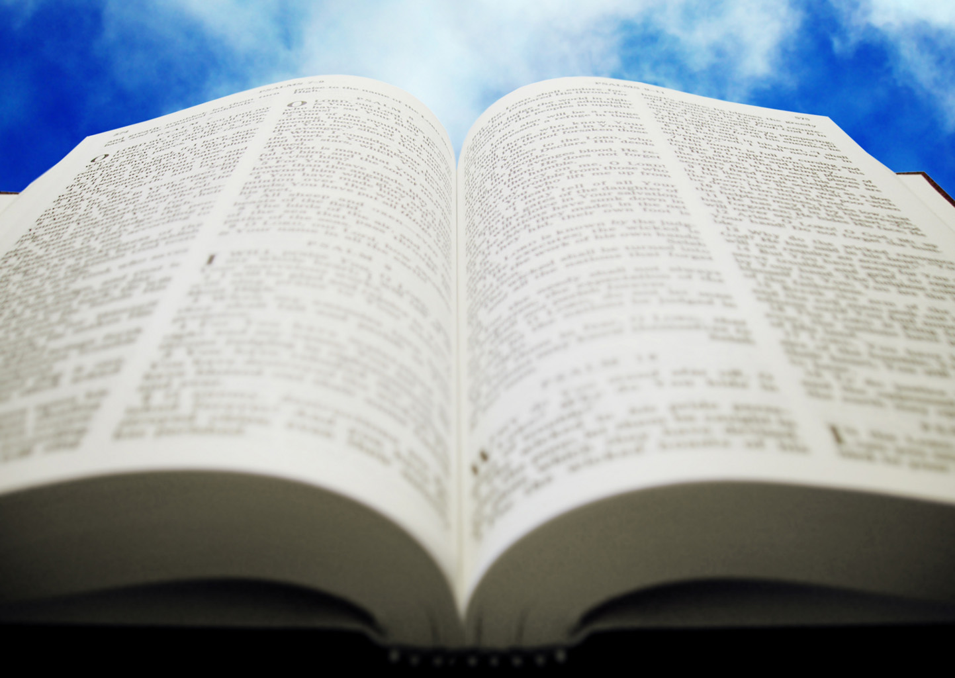
Welcome!
Sunday
Bible Study 9:30 AM
Worship 10:30 AM
PM Bible Class (Livestream) 5:00 PM
Wednesday
Bible Class 7:00 PM
www.SunsetchurchofChrist.net

Slide 2
John 4:15-24
Worship in Spirit and Truth
Spirit: John 6:63, 1 Cor. 2:12-16
Truth: John 17:17
Differences between worship then and now?

Slide 3
John 4:25-30
Knowledge of the Messiah
The conclusion of the confrontation

Slide 4
John 4:31-38
Jesus and the food of God
“The fields are white for harvest”

Slide 5
John 4:39-44
The conclusion of the Samaritan interaction
Contrasted with Galilee

Slide 6
Welcome!
Sunday
Bible Study 9:30 AM
Worship 10:30 AM
PM Bible Class (Livestream) 5:00 PM
Wednesday
Bible Class 7:00 PM
www.SunsetchurchofChrist.net

Slide 7
Opening Prayer
Song – 20 | George Watkins
Scripture Reading
Song – 105 | George Watkins
Song – 171 | George Watkins
Lord’s Supper
Song – 97 | George Watkins
Collection
Song – 155 | George Watkins
Lesson | Brian Haines
Song – 300 | George Watkins
Closing

Slide 8
Notes:
Most people do not like themselves in some way. They do not like the way they look, they dislike themselves in general, or they have no confidence or self esteem.

Slide 9
Do you like yourself?
Notes:
Most people do not like themselves in some way. They do not like the way they look, they dislike themselves in general, or they have no confidence or self esteem.

Slide 10
Christian’s Love Themselves
Paul’s admonition to Timothy – 1 Timothy 5:23
Husbands and wives – Ephesians 5:29-33
Parable of the unjust steward – Luke 16:1-8
Notes:
Eph 5:29 For no one ever hated his own flesh, but nourishes and cherishes it, just as the Lord does the church.Eph 5:33 Nevertheless let each one of you in particular so love his own wife as himself, and let the wife see that she respects her husband.
Lu 16:8 "So the master commended the unjust steward because he had dealt shrewdly. For the sons of this world are more shrewd in their generation than the sons of light.

Slide 11
Christian’s Love Themselves
Made in the image of God
Remade in the image of Christ
Beloved of God

Slide 12
Christian’s Love Themselves
Why then do so many of us dislike ourselves?
Not taking care of ourselves
Ashamed to act

Slide 13
Signs of Broken Self Image
Lack of confidence in action - Moses
Self-destructive and sinful behavior - Saul
Refusal to improve our condition – Israel
Depression and anger – Cain
Blame and victimhood - Esau

Slide 14
Reasons for Our Behavior
1. We don’t understand the meaning of love
Proverbs 27:5-6
1 John 2:15
Notes:
Pr 27:5 ¶ Open rebuke is better Than love carefully concealed. 6 Faithful are the wounds of a friend, But the kisses of an enemy are deceitful.2Co 10:7 ¶ Do you look at things according to the outward appearance? If anyone is convinced in himself that he is Christ's, let him again consider this in himself, that just as he is Christ's, even so we are Christ's.
1Jo 2:15 Do not love the world or the things in the world. If anyone loves the world, the love of the Father is not in him.

Slide 15
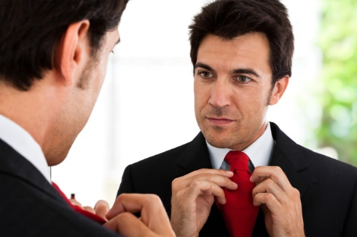
Reasons for Our Behavior
2. We measure ourselves by worldly standards
1 Samuel 16:7
2 Corinthians 10:7,12
Notes:
1Sa 16:7 But the LORD said to Samuel, "Do not look at his appearance or at the height of his stature, because I have refused him. For the LORD does not see as man sees; for man looks at the outward appearance, but the LORD looks at the heart.“
2Co 10:7 ¶ Do you look at things according to the outward appearance? If anyone is convinced in himself that he is Christ's, let him again consider this in himself, that just as he is Christ's, even so we are Christ's.
2Co 10:12 ¶ For we dare not class ourselves or compare ourselves with those who commend themselves. But they, measuring themselves by themselves, and comparing themselves among themselves, are not wise.

Slide 16
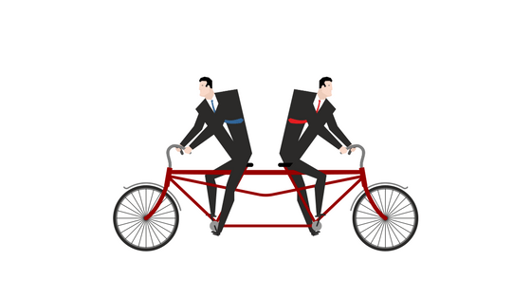
Reasons for Our Behavior
3. We have a divided allegiance
1 Kings 18:21
Matthew 6:24
Notes:
1Ki 18:21 ¶ And Elijah came to all the people, and said, "How long will you falter between two opinions? If the LORD is God, follow Him; but if Baal, follow him." But the people answered him not a word.
Mt 6:24 "No one can serve two masters; for either he will hate the one and love the other, or else he will be loyal to the one and despise the other. You cannot serve God and mammon.

Slide 17
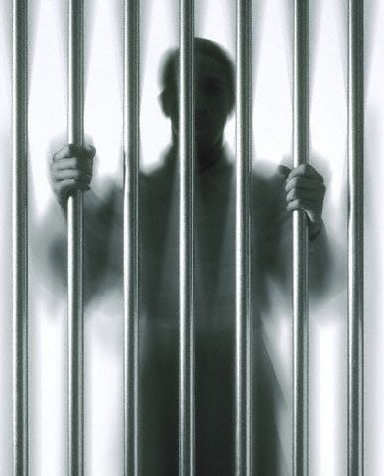
Reasons for Our Behavior
4. We won’t hold ourselves accountable
1 Samuel 15:20-22
John 15:1-2
Notes:
1Sa 15:20 And Saul said to Samuel, "But I have obeyed the voice of the LORD, and gone on the mission on which the LORD sent me, and brought back Agag king of Amalek; I have utterly destroyed the Amalekites. 21 "But the people took of the plunder, sheep and oxen, the best of the things which should have been utterly destroyed, to sacrifice to the LORD your God in Gilgal." 22 Then Samuel said: "Has the LORD as great delight in burnt offerings and sacrifices, As in obeying the voice of the LORD? Behold, to obey is better than sacrifice, And to heed than the fat of rams.
Joh 15:1 ¶ "I am the true vine, and My Father is the vinedresser. 2 "Every branch in Me that does not bear fruit He takes away; and every branch that bears fruit He prunes, that it may bear more fruit.

Slide 18
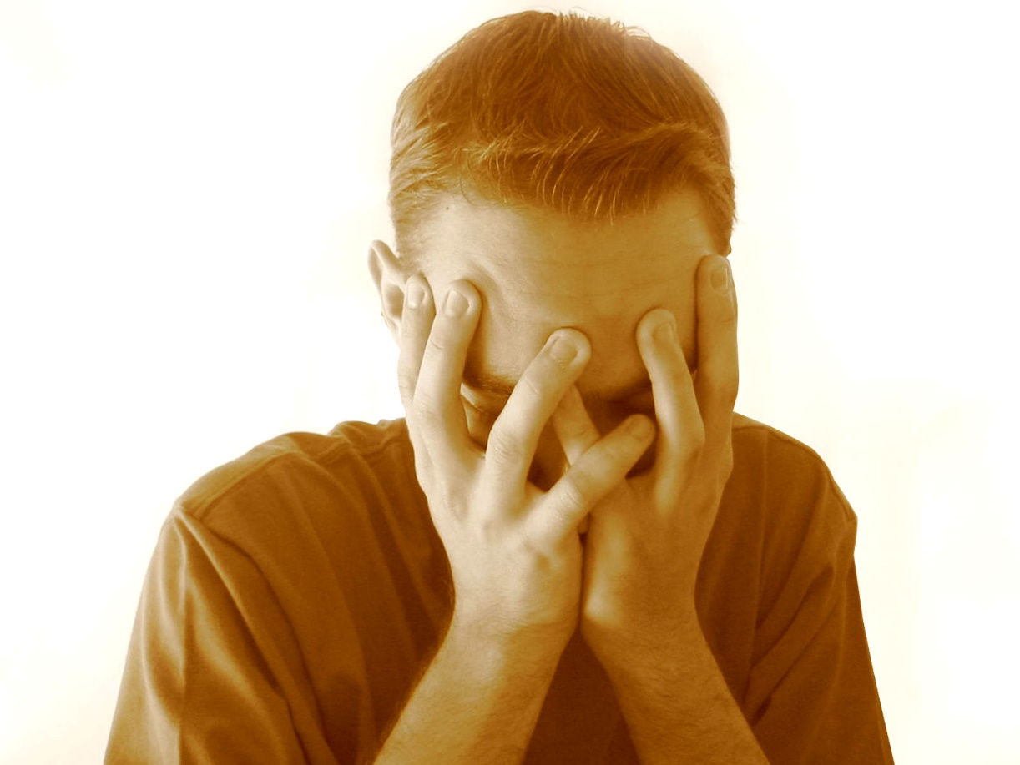
Reasons for Our Behavior
5. We allow guilt to overwhelm us
2 Samuel 17:23
Matthew 27:5
Notes:
2Sa 17:23 Now when Ahithophel saw that his advice was not followed, he saddled a donkey, and arose and went home to his house, to his city. Then he put his household in order, and hanged himself, and died; and he was buried in his father's tomb.
Mt 27:5 Then he threw down the pieces of silver in the temple and departed, and went and hanged himself.

Slide 19
Reasons for Our Behavior
5. We allow the feeling of guilt to overwhelm us
1 Samuel 16:7
1 Timothy 1:13
Notes:
1Ti 1:13 although I was formerly a blasphemer, a persecutor, and an insolent man; but I obtained mercy because I did it ignorantly in unbelief.

Slide 20
Seeing Yourself in Perspective
For if anyone is a hearer of the word and not a doer, he is like a man observing his natural face in a mirror; for he observes himself, goes away, and immediately forgets what kind of man he was. But he who looks into the perfect law of liberty and continues in it, and is not a forgetful hearer but a doer of the work, this one will be blessed in what he does. James 1:23-25

Slide 21
Seeing Yourself in Perspective
God knows you are not perfect
For we do not have a High Priest who cannot sympathize with our weaknesses, but was in all points tempted as we are, yet without sin. Hebrews 4:15

Slide 22
Seeing Yourself in Perspective
God knows you are not perfect
God desires to forgive your sins
If we confess our sins, He is faithful and just to forgive us our sins and to cleanse us from all unrighteousness. 1 John 1:9

Slide 23
Seeing Yourself in Perspective
God knows you are not perfect
God desires to forgive your sins
God sees you as valuable to His purpose
But now God has set the members, each one of them, in the body just as He pleased 1 Corinthians 12:18

Slide 24
The Importance of Perspective
You will not succeed if you feel unworthy
You will succumb to sin if you feel weak
You will meet God’s expectations if you try

Slide 26
What Is Best For You?
1) Eternal life
Hearing and Believing
Confession
Repentance
Baptism
2) Life of personal sanctification

